Slide 1
USAF-558 - Supply Chain Communication
Carter Vannelli
Matthew Glos
Hao Wang
Ryan Becker
Liuhai Wang

Slide 2
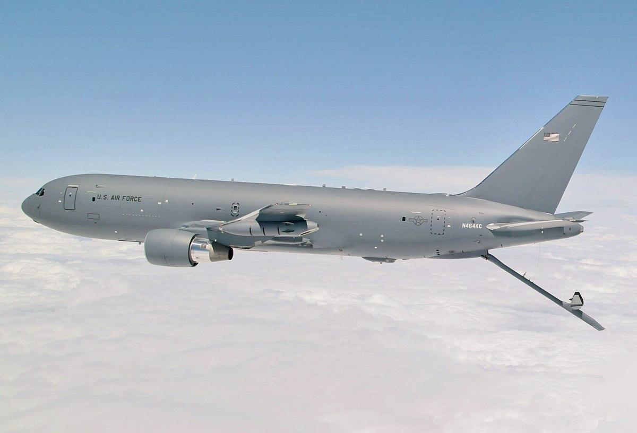
Introduction（steps of ordering system)
Requirements Identification(like number of refueling machines)
Procurement Process(The Air Force issues a formal request for proposals)
Production & Development(The supplier designs the prototype according to the contract requirements)
Delivery & Acceptance(Delivery of the aircraft to the Air Force, and check the performance)
Maintenance & Upgrades

Slide 3
Beneficiary Discovery
Daniel P. Schubert
Aaron Dangelillo
500+ coworkers
Jeffrey R. Porter
Cancelled

Slide 4
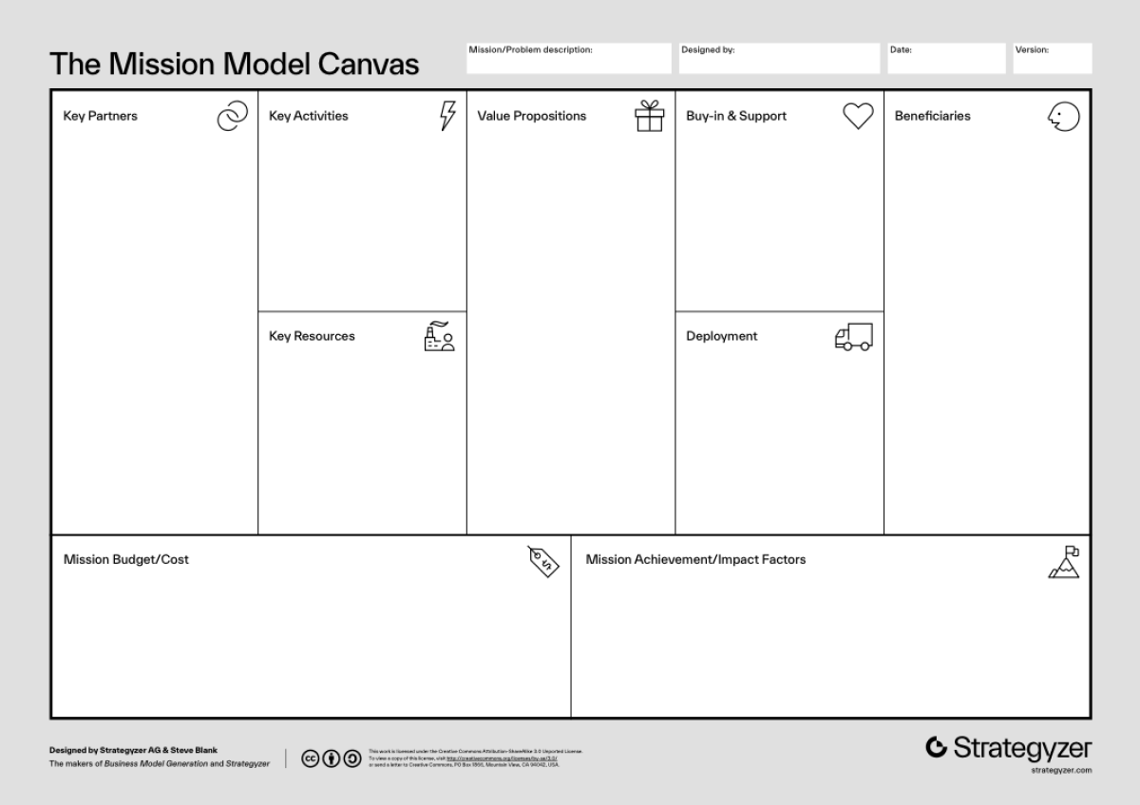
Mission Model Canvas
v3
USAF,
KC-46 Crew,
AAR Mobility Systems,
Boeing
Improve the part ordering process
Simplify the parts ordering process
Improving maintenance efficiency
Enhance inventory management
Improve part delivery reliability
KC-46 Crew,
AAR Mobility Systems,
USAF
KC 46 Aircraft Maintenance Squadron,
Aircraft Pilots,
Logistics Squadron,
Other members on the base
Technical order system
NSN database
G081 ordering system
AAR mobility catalogue
Phase 1: Research and Interviews
Phase 2: MVP development and testing
Allow end-users to more efficiently inventory,
order, and maintain equipments

Slide 5
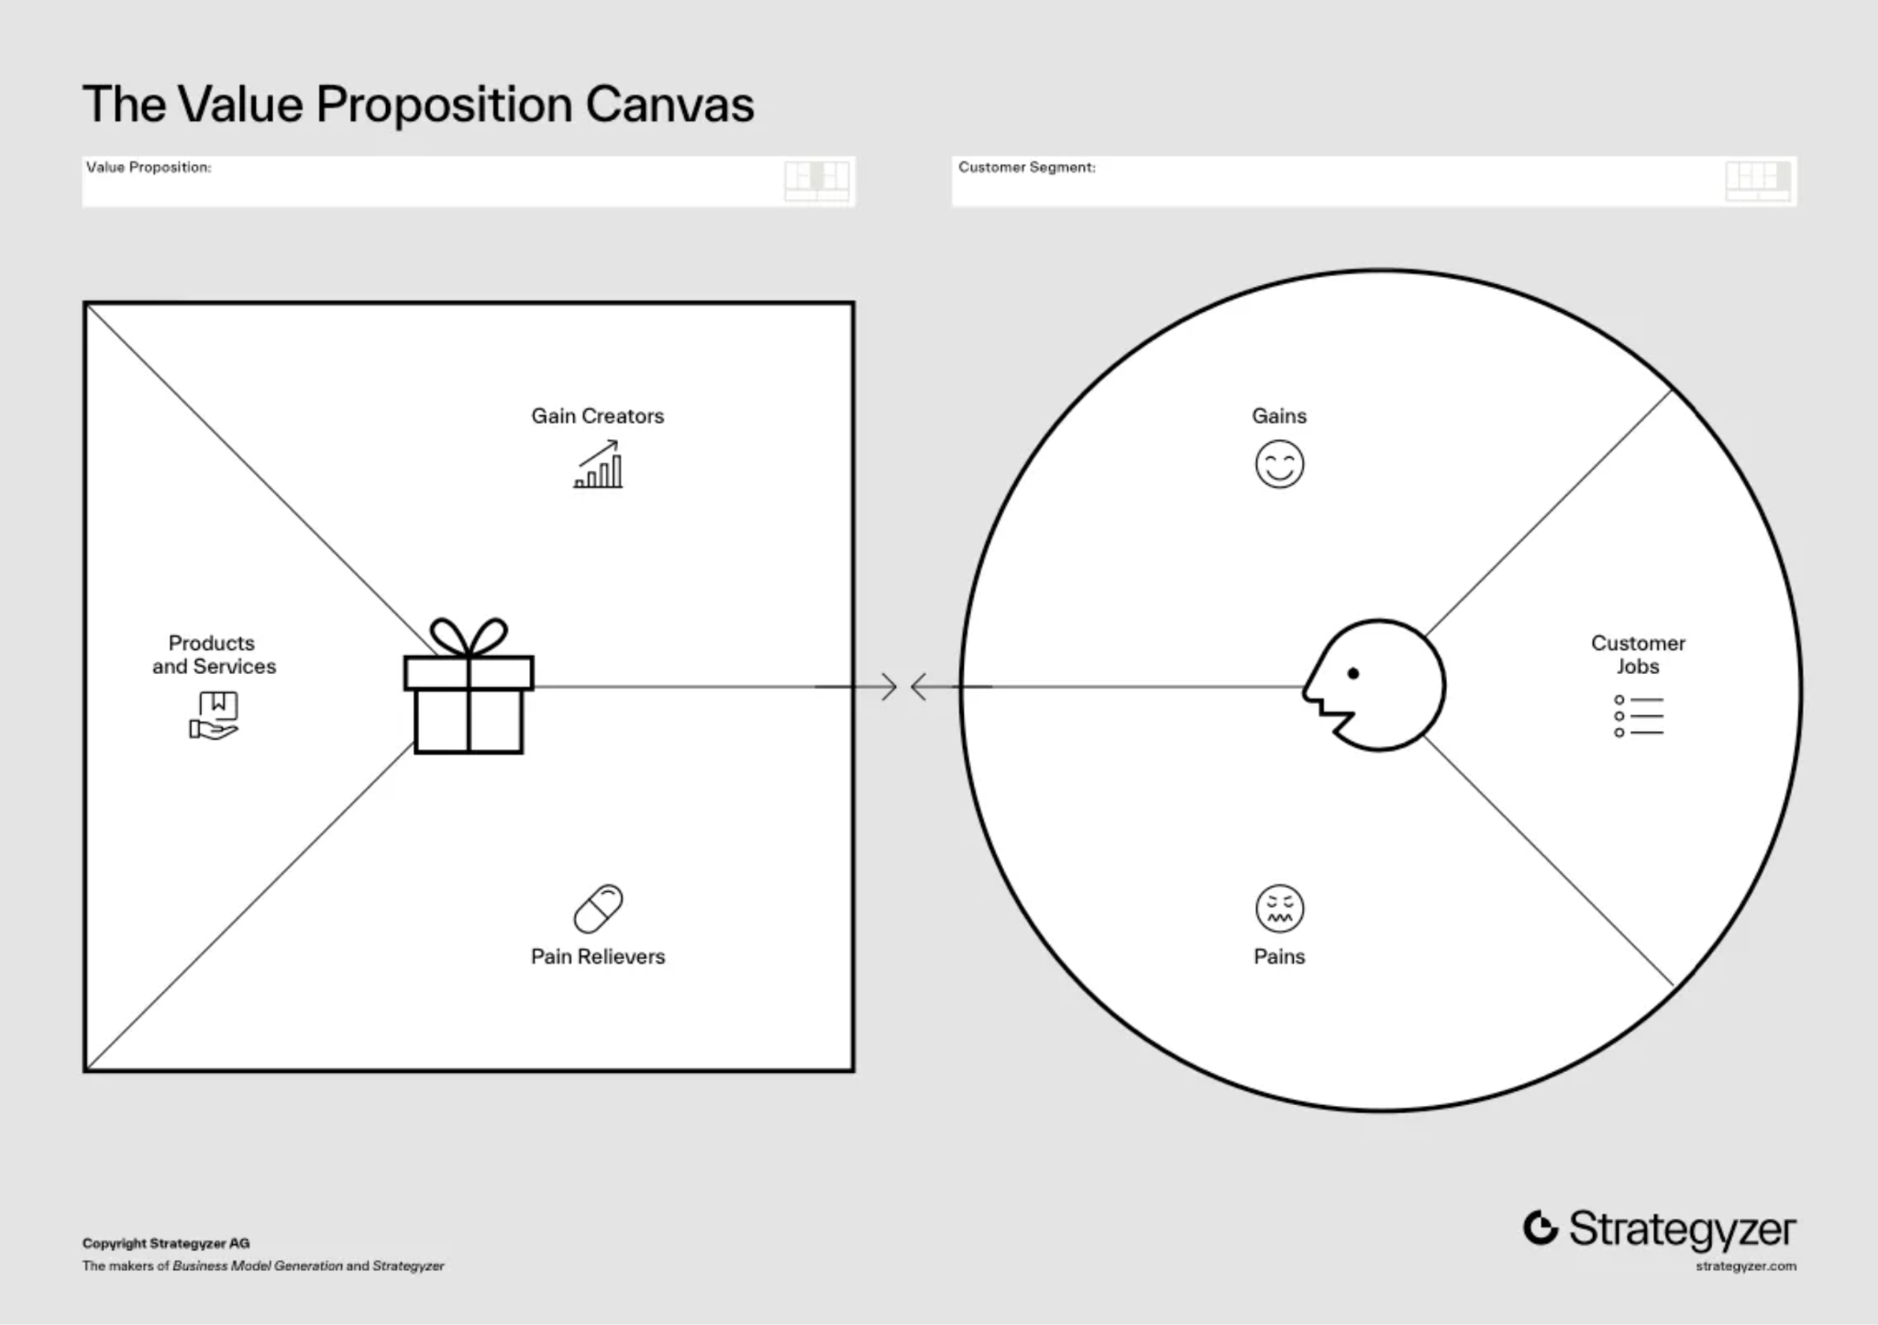
Value Proposition Canvas
Maintain and manage the KC-46 crew
Timely ordering and receiving of parts
Optimize inventory management
Improved efficiency of aircraft maintenance
Optimize inventory management
Complex parts ordering process
Excessive ordering time
Poor supply chain communication
Messy inventory management
Simplify the ordering process
Optimize supply chain communication
Enhance inventory management capabilities

Slide 6
Parts Ordering Outline
Broken Part
G081
On Base Supply
Boeing
AAR Mobility
NSN
Part Number

Slide 7
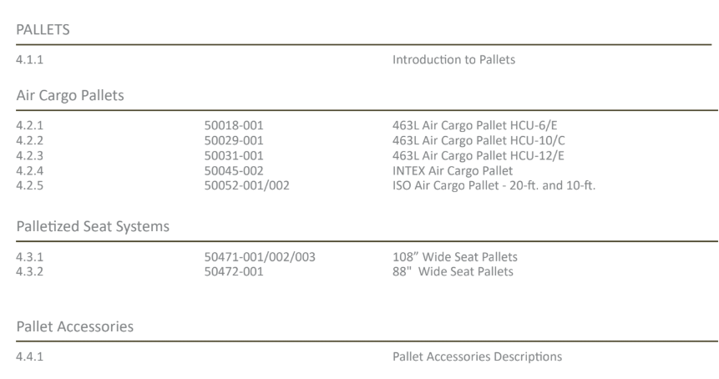
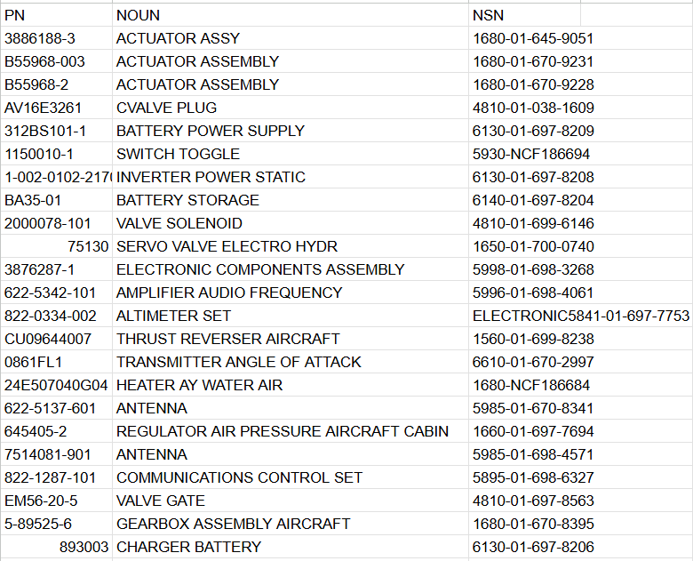
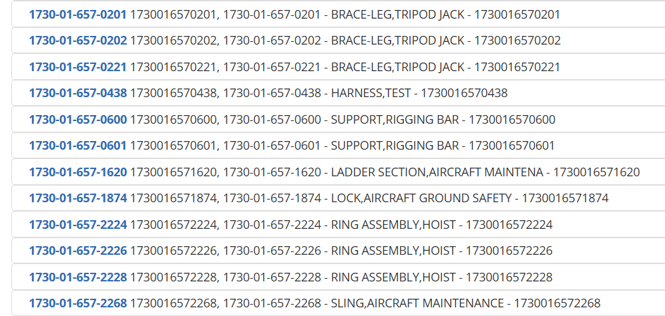
AAR Mobility Part numbers
Commonly replaced parts
ISO Standard NSN numbers (125M parts)

Slide 8
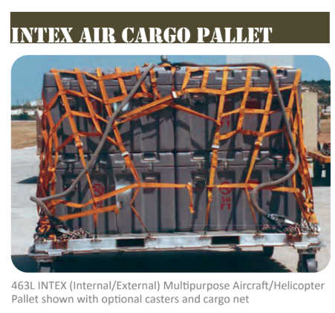
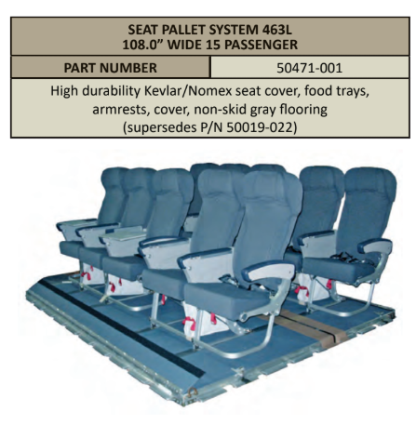
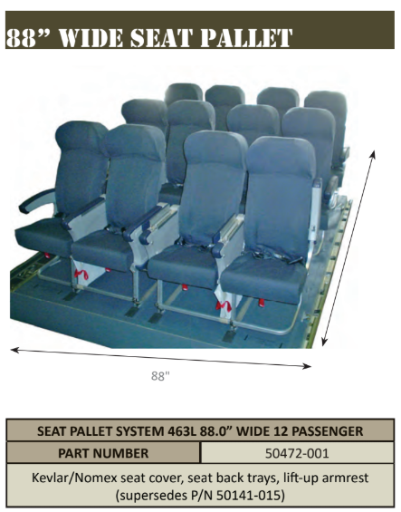

Slide 9
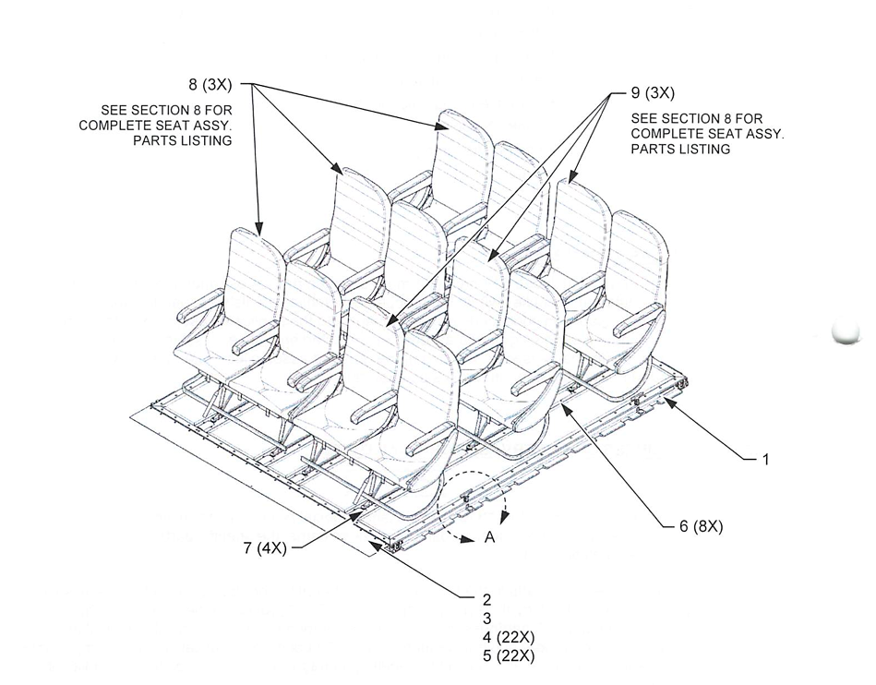

Slide 10

Interviews & Experiments
Daniel P. Schubert
Aaron Dangelillo
Notes:
The employees from Boeing. They had a lot of insight into the actual system and the workarounds they took to update the content.

